Slide 1
All you need to know about AI and ML
Mutaz Abu Ghazaleh
Data & AI Solution Architect
Rita Arrigo
Chief Digital Advisor
UN/CONF Melbourne 2018

Slide 2
Agenda
1. Overview of AI and ML
2. Developing AI – The AI Platform
3. Demos & Learning
Intelligent Kiosk – Demo And Experience
Machine Learning Demo
Intelligent Customer Care Bot Demo
4. AI In Financials
AI Challenge with Team Data Science Approach
5. Lets Build a Bot
6. More Learnings, Offers and about Rita and Mutaz

Slide 3
Part 1: Overview of AI and ML

Slide 4
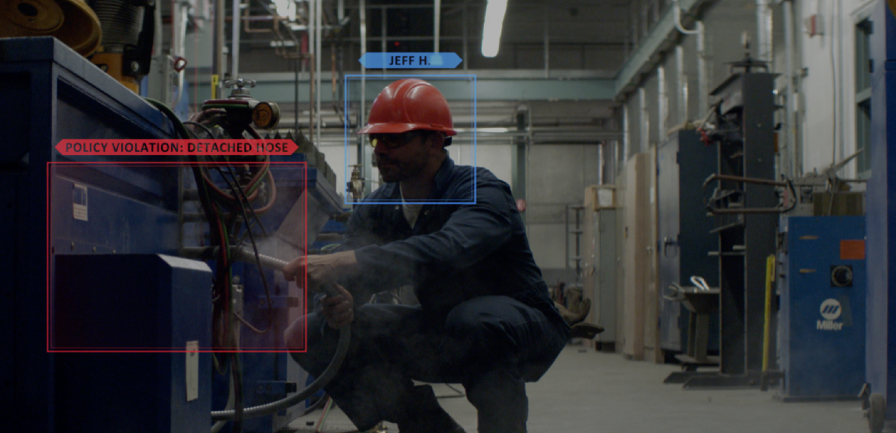
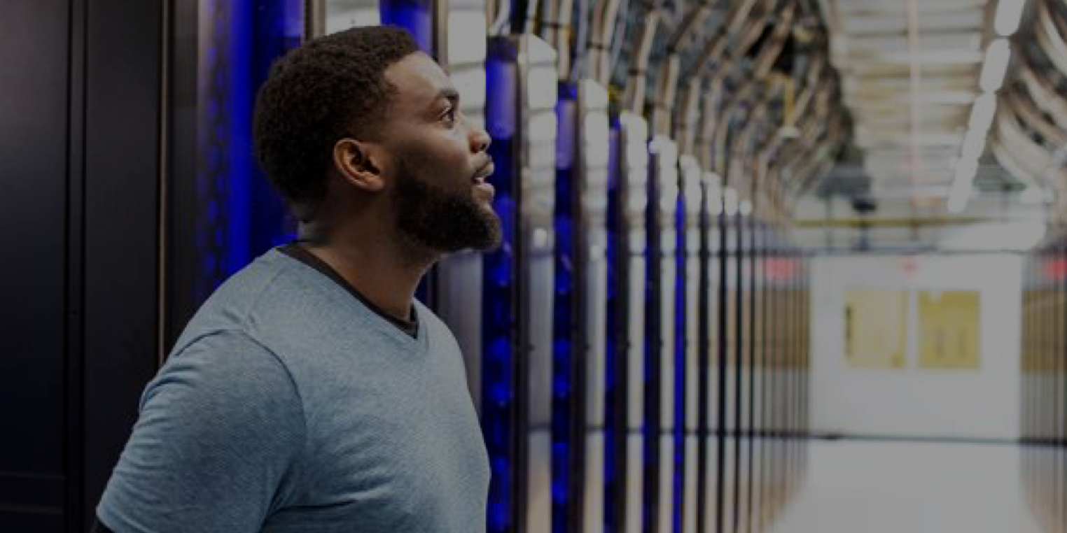
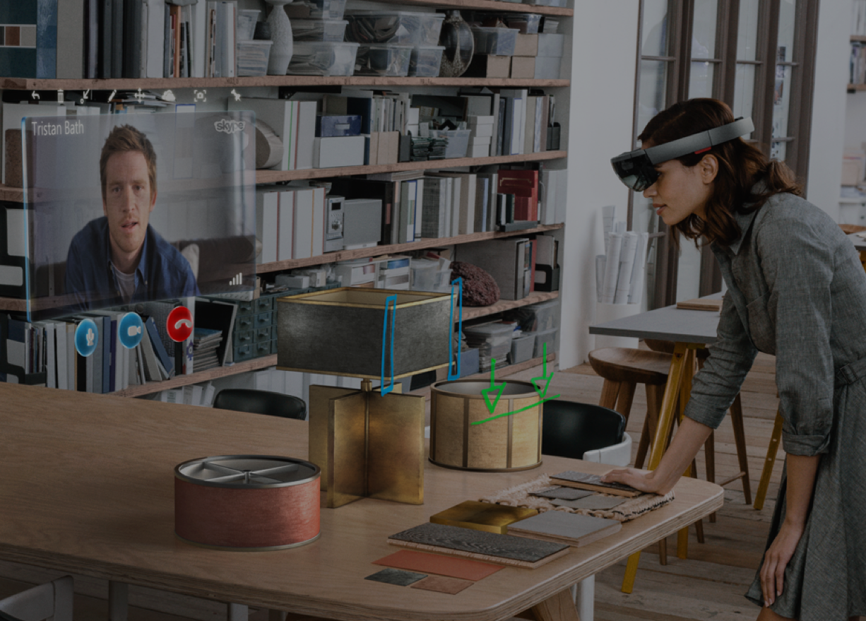
Foundation for AI
Data
Cloud
Models
Vision
Speech
Language
Your data + Microsoft data
Power of Azure
Breakthrough advancements

Slide 5




Microsoft AI breakthroughs
Vision
Speech
Speech
Language
Language
Switchboard
Meeting speech
96%
RESNET vision test 152 layers
5.1%
Switchboard speech recognition test
69.9%
MT research system
88.5%
SQuAD reading comprehension test
Broadcast speech
Switchboard cellular
IBM Switchboard
1993
2000
2006
2010
2017
2016
Object recognition Human parity
2017
Speech recognition Human parity
March 2018
Machine translation Human parity
January 2018
Machine reading comprehension Human parity

Slide 6
Microsoft AI momentum
Vision
Speech
Language
Switchboard
Meeting speech
1.2M devs
Using Azure Cognitive Services
340K devs
Creating digital agents with Azure Bot Service
60 languages
Supported by PowerPoint Translator live feature
35T docs
Processed by machine reading
Broadcast speech
Switchboard cellular
IBM Switchboard
1993
2000
2006
2010
2017

Slide 7




Bringing AI together - To sense, comprehend and act
Sense
Comprehend
Act
Computer vision and audio processing, for example are able to actively perceive the world around them by acquiring and processing images, sounds and speech.
Natural language processing and inference engines can enable AI systems to analyse and understand the information collected.
An AI system can take action through technologies such as expert systems and inference engines or undertake actions in the physical world.
Emerging AI technologies
Computer Vision
Audio Processing
Natural Language Processing
Knowledge Representation
Machine Learning
Expert Systems
Illustrative Solutions
…
Defect Detection
Identity
Analytics
Machine Comprehension
Speech
Analytics
Recommendation
Systems
Virtual Agents
Source: Accenture: Why artificial intelligence is the future of growth, April 2016
Notes:
Sensing: planning and navigating through

Slide 8
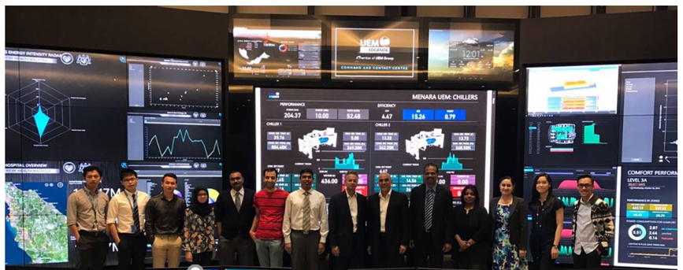
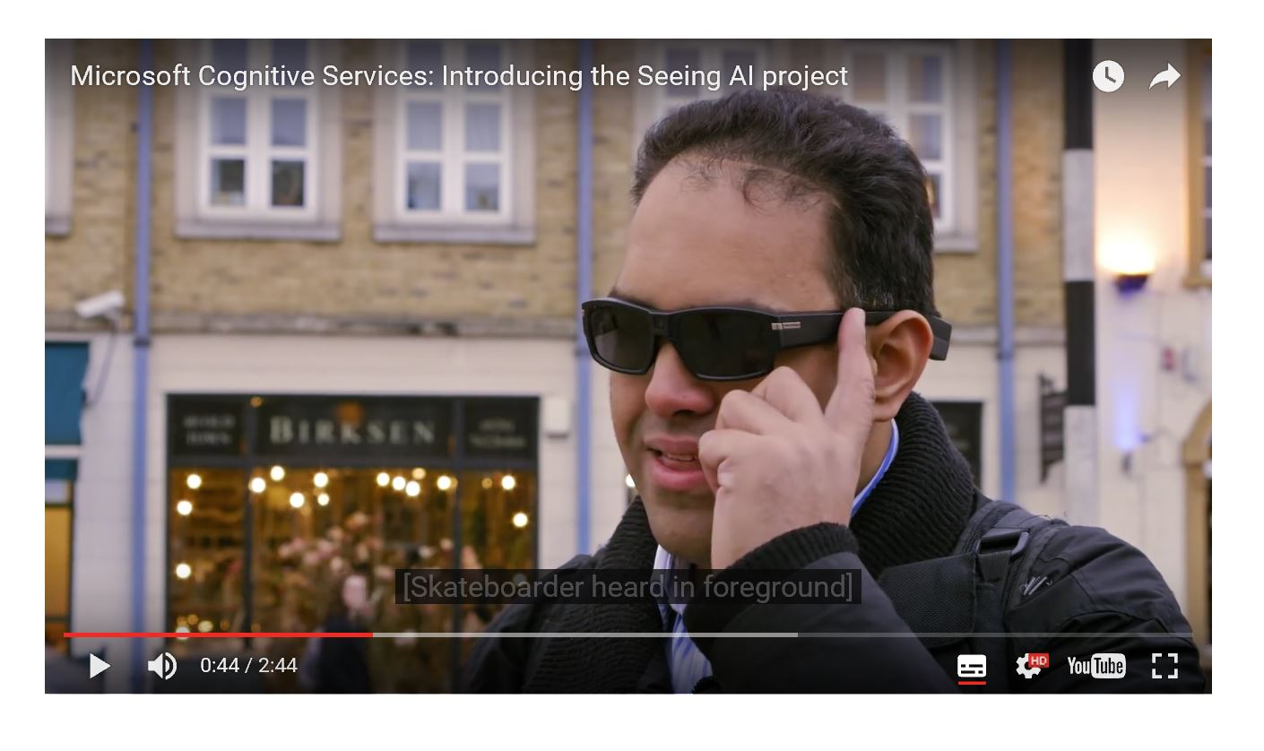
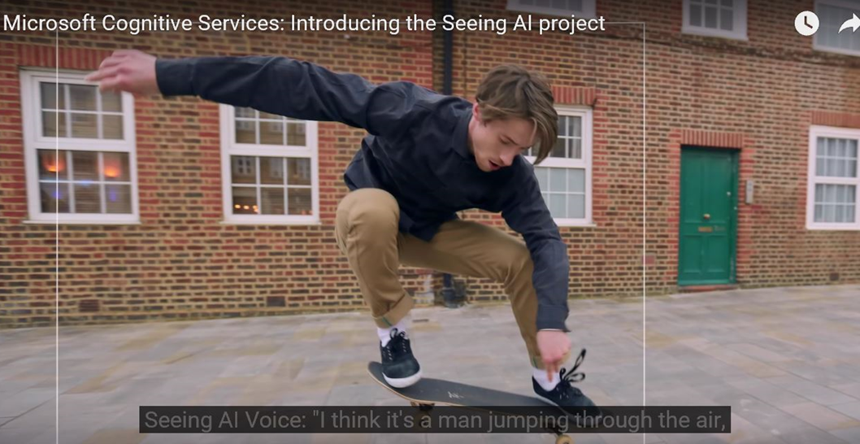
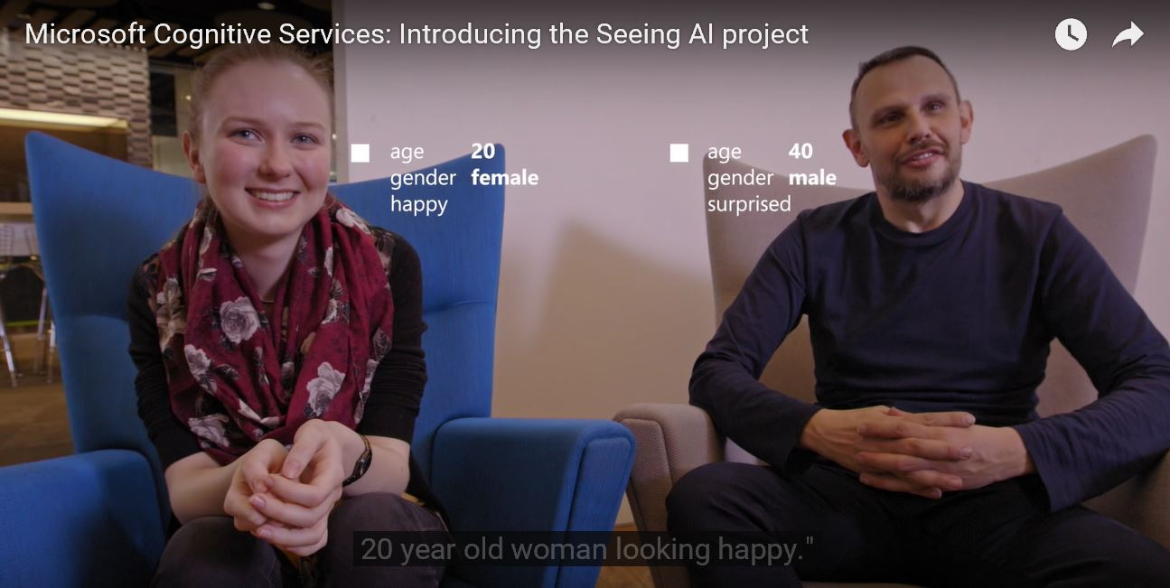

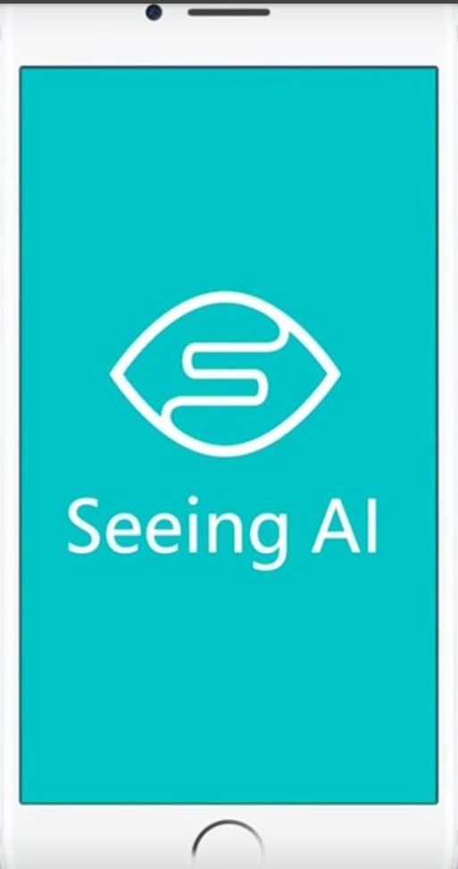
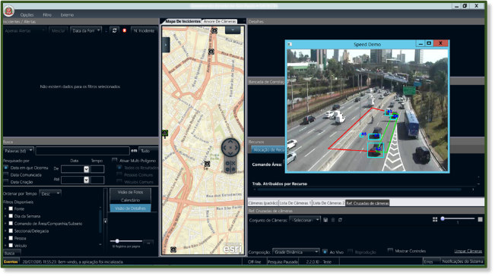

Integrating AI technologies into compelling business solutions
Sense
Traditionally, facilities management has been a manually intensive operation requiring technicians to regularly visit buildings to perform inspections and maintenance activities. UEM was looking to smart building capabilities, such as IoT and advanced analytics, to enable them to reduce the amount of human effort required to provide building services and to enable them to improve the level of service provided to building owners and tenants.
Computer vision and audio processing, for example are able to actively perceive the world around them by acquiring and processing images, sounds and speech.
Computer Vision - Acquiring, processing, analysing and understand images
Sensor Processing - Processing and analysing information from sensors other than cameras and microphones
Audio Processing - Identifying, recognizing and analysing sounds and speech
Analyses multiple live video streams
Fully integrated with DAS system
Low camera and CPU requirements
Highly optimized multithreaded code
Detects events in real-time (15+fps)
Generates geocoded XML alerts

Slide 9
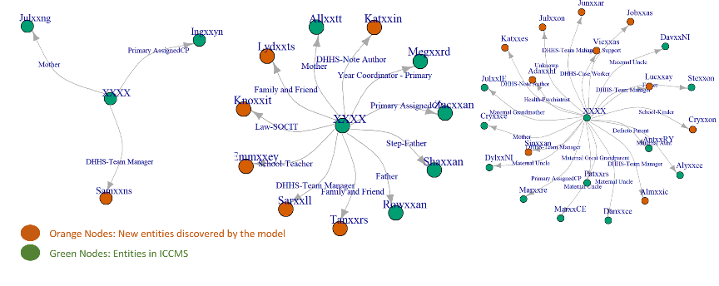
Integrating AI technologies into compelling business solutions
Comprehend
Natural language processing and inference engines can enable AI systems to analyse and understand the information collected.
Natural language processing - Understanding and generating language in spoken and/or written form
Interpret Dark Data
Knowledge representation - Depicting and communicating knowledge to facilitate inference and decision making

Slide 10
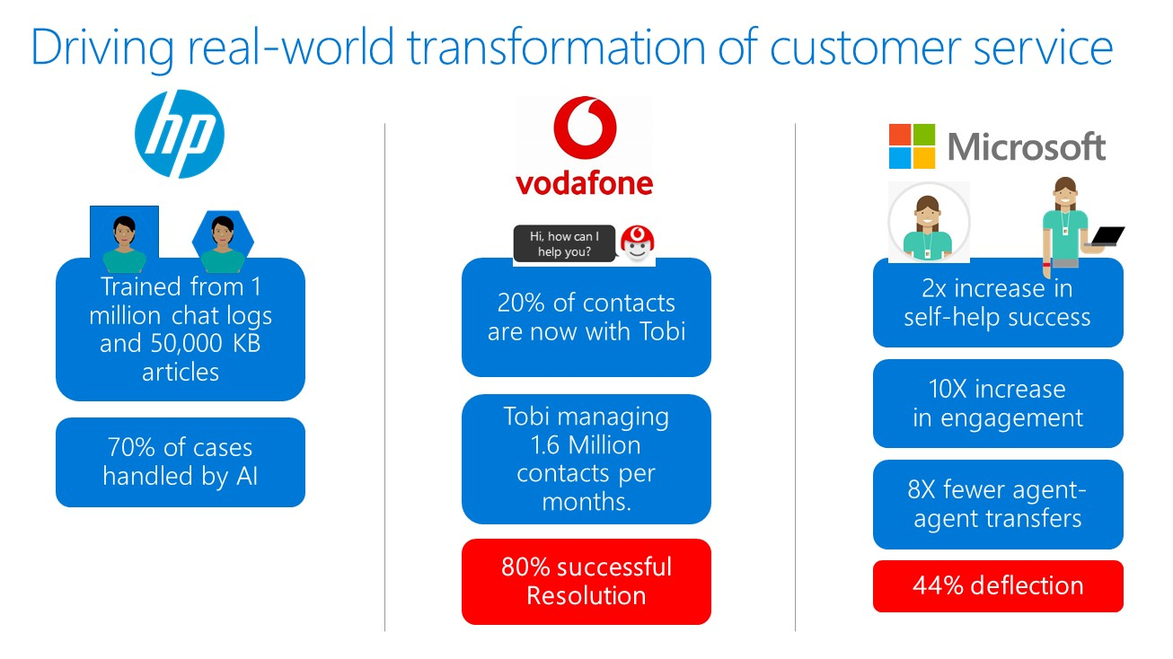
Integrating AI technologies into compelling business solutions
Act
An AI system can take action through technologies such as expert systems and inference engines or undertake actions in the physical world.
Inference engines - Deriving answers from a static knowledge base such as business rules
Expert systems - Emulating the decision-making ability of a human expert & solving complex problems by reasoning with the information available in its knowledge base
Machine learning - Altering the decision process based on experience

Slide 11
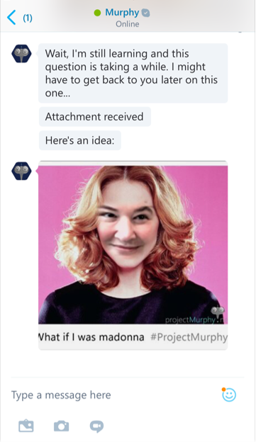
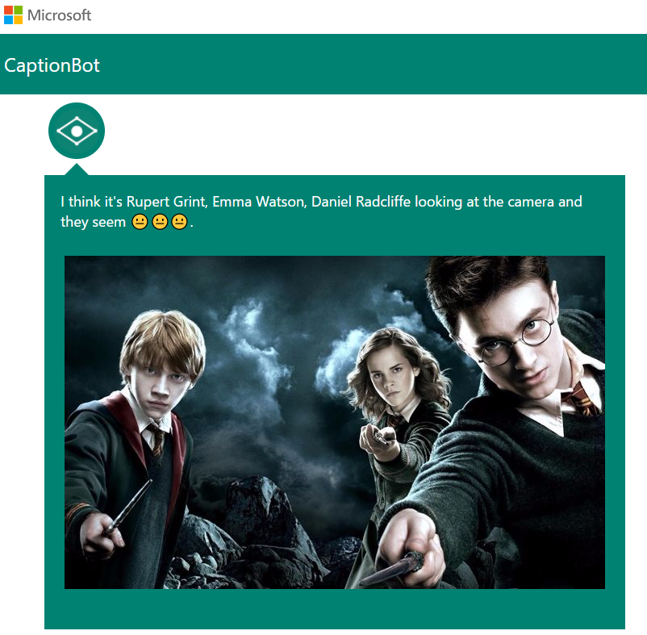
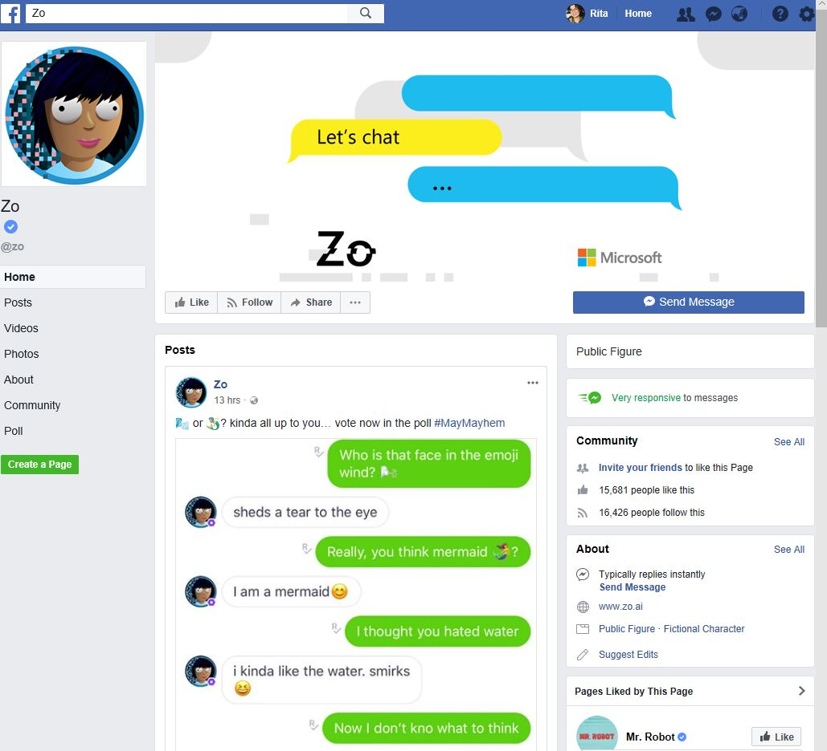
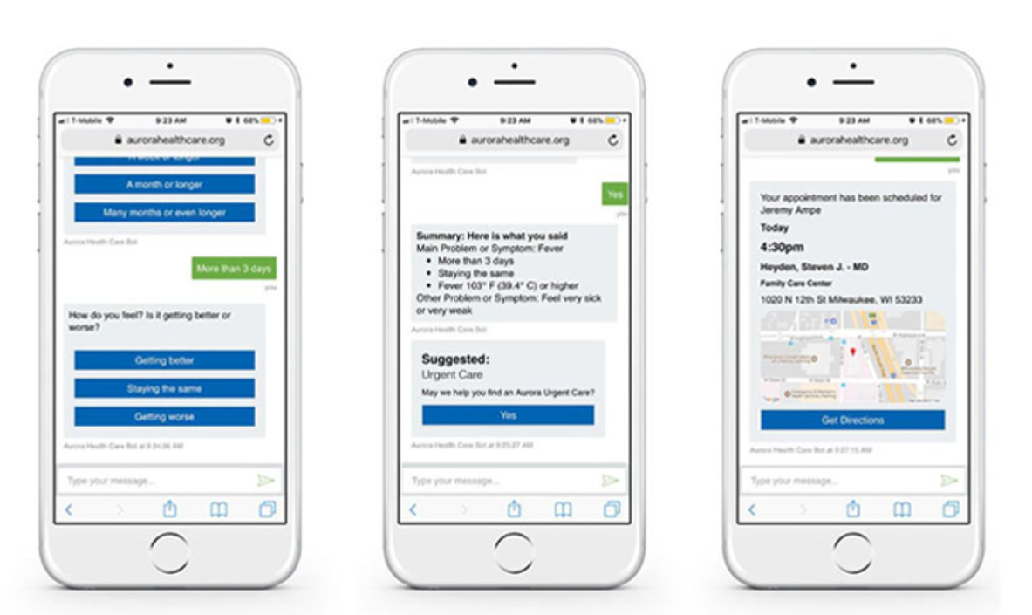
Zo on Messenger
ProjectMurphy.net
CaptionBot.ai
Microsoft Health Bot
Notes:
Here are some examples of some of the more lowfi innovations that are powered by our bot framework.
Here you can see I’ve been able to use Project Murphy to see what I would look like as a young boy!

Slide 12
Beyond Apps
Digital
Experiences
Mixed reality
Devices (phones, speakers, PCs)
Smart
Enabled by AI
Touch devices
Fast
Responsive, perform when needed
Wearables
Helpful
Right experience at the right time
Gaming
Inclusive
Span environments
Accommodates differently-abled

